Slide 1
‎Exploratory Data Analysis
2022 Semester2
Group 29
Zhiyuan Chen
Zhi Hern Tom
Ya Cho
Suyi Jiao
Zhuoling Chen

Slide 2
Preliminary questions
For condition:
Patient having open heart surgery: cohort of patient with CABG
After they have left the operating room: time after the latest outtime of careunit = 'Cardiac Surgery’
For corresponding tests:
Hemoglobin(Hb) : the measured hemoglobin(from lab table in mimic_hosp)
Blood transfusion : packed red cell (from inputevent table in mimic_icu)
Notes:
review on the question we analyse on: the two condition and two type of measurement: hemoglobin and blood transfusion

Slide 3
Measurement
Value diff = Pre-transfusion value - Post-transfusion value
Pre-transfusion
hemoglobin
Blood transfusion
Post-transfusion
hemoglobin
Notes:
here is a simple timeline graph show the relationship between those measurement we focus on:
value before is the last hemoblobin value measured before the first blood transfusion
while value after is the first hemoblobin value measured after first blood transfusion;
value diff is just the diffrence between value after and value diff;
and the unit for Hb is g/dl

Slide 4
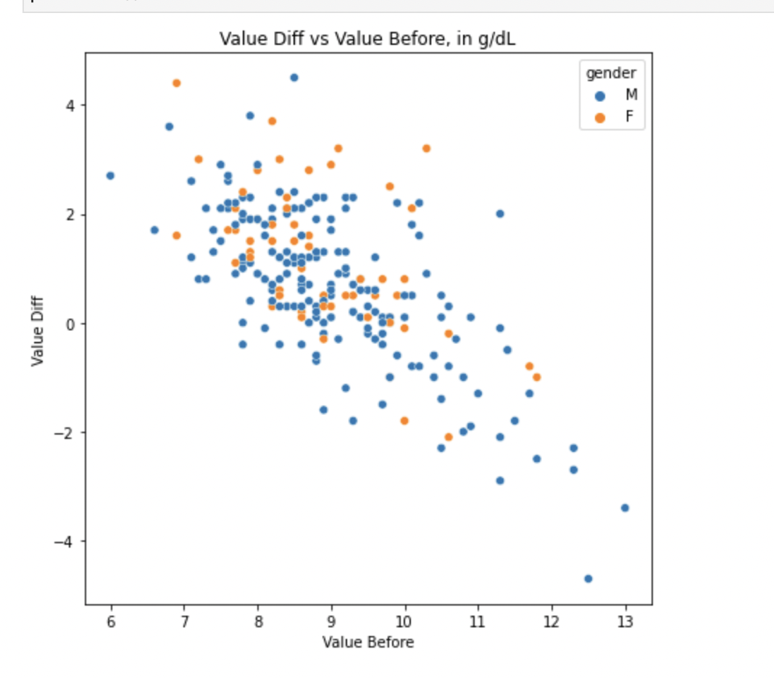
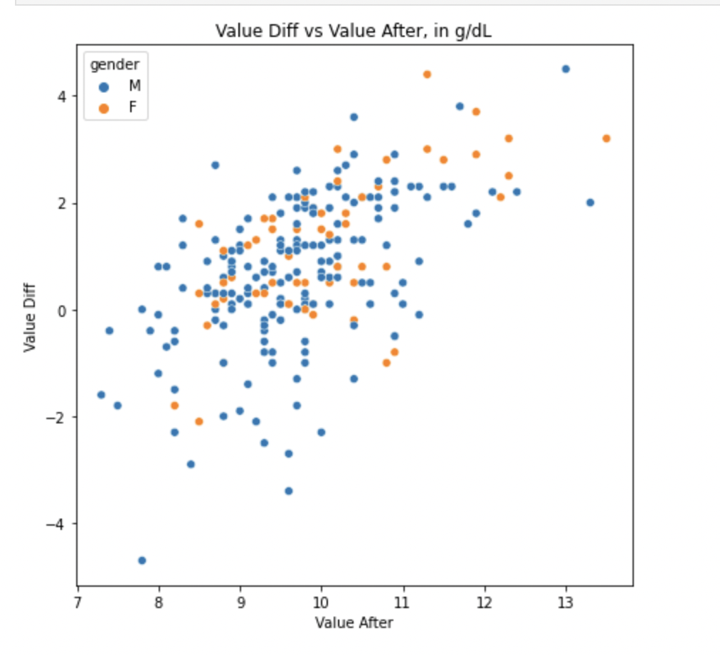
EDA-hemoglobin
Notes:
relative strong negative correlation between value before and value diff, as value before increase the value diff decrease; oppositely from right scatter plot as value after increase, value diff increase

Slide 5
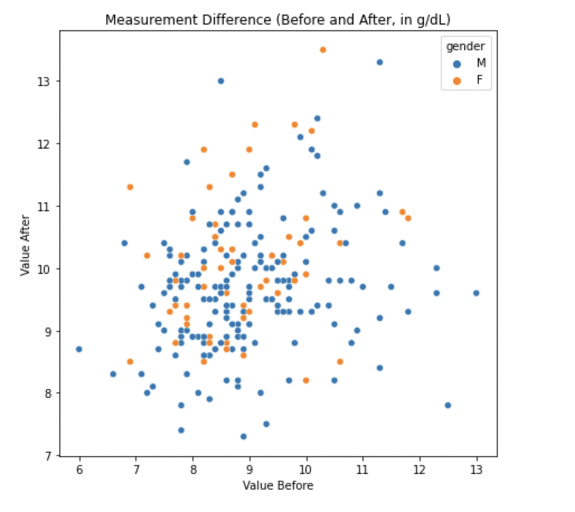
EDA-hemoglobin
Notes:
there is no clear relationship shown on the plot; what we can say is most of the point locatend on value before 7.5-9 and value after 8.5-10.5

Slide 6
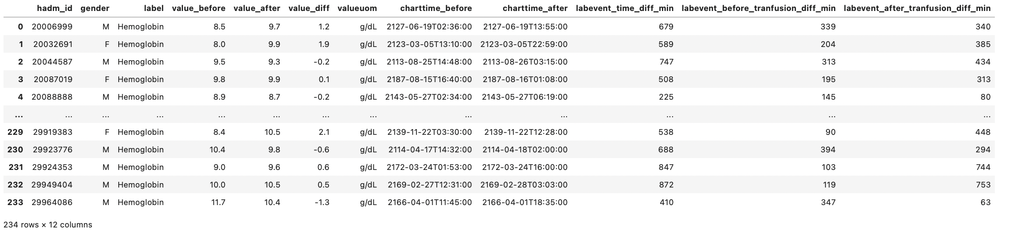
EDA-hemoglobin
What is the time difference between measurements and the first blood transfusion?
Notes:
Next, we try to figure out whether there is some correlation between the time gap and the time measurement value

Slide 7
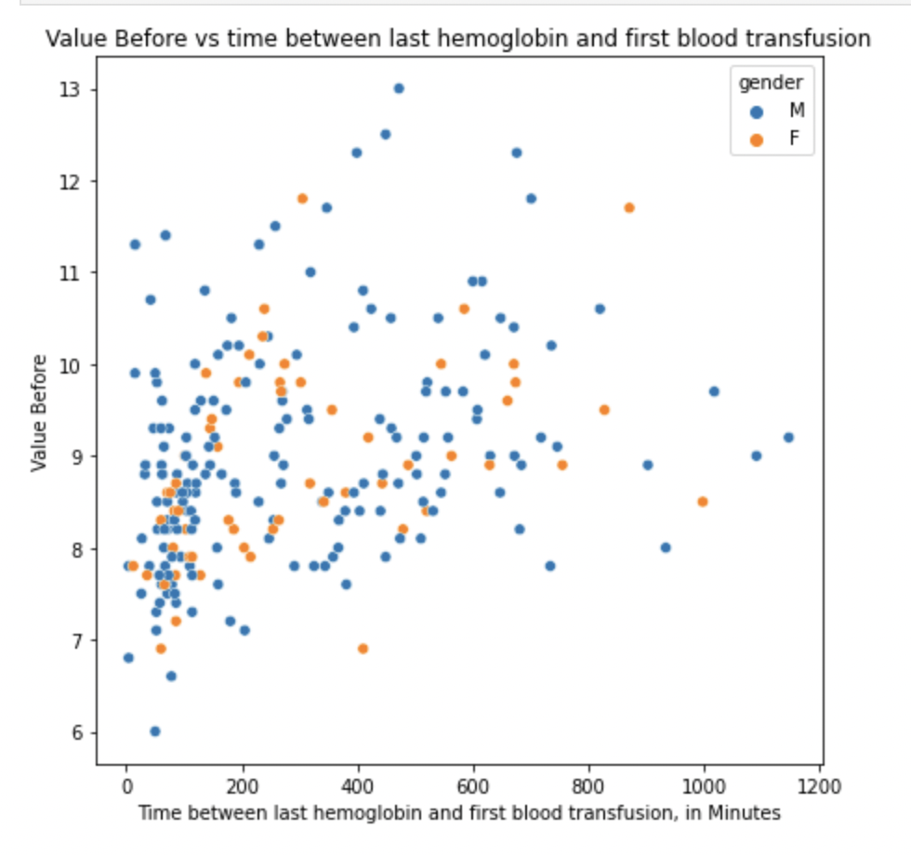
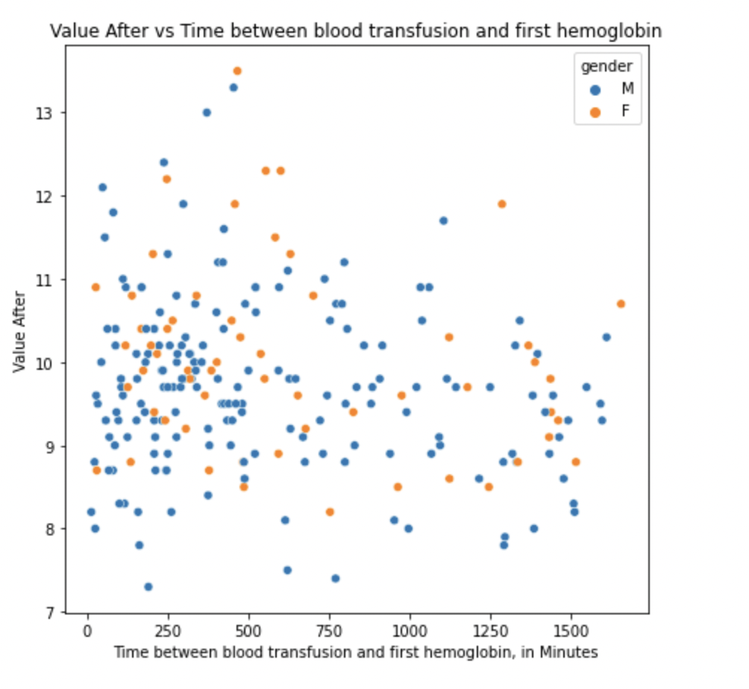
EDA-hemoglobin
Notes:
From scatter plot for value before vs time between last Hb and first blood; time is short, it more likely to observe low Hb value which we can not see from right scatter plot
As the right plot value after vs time between first blood and first Hb is more evenly dispersed。

Slide 8
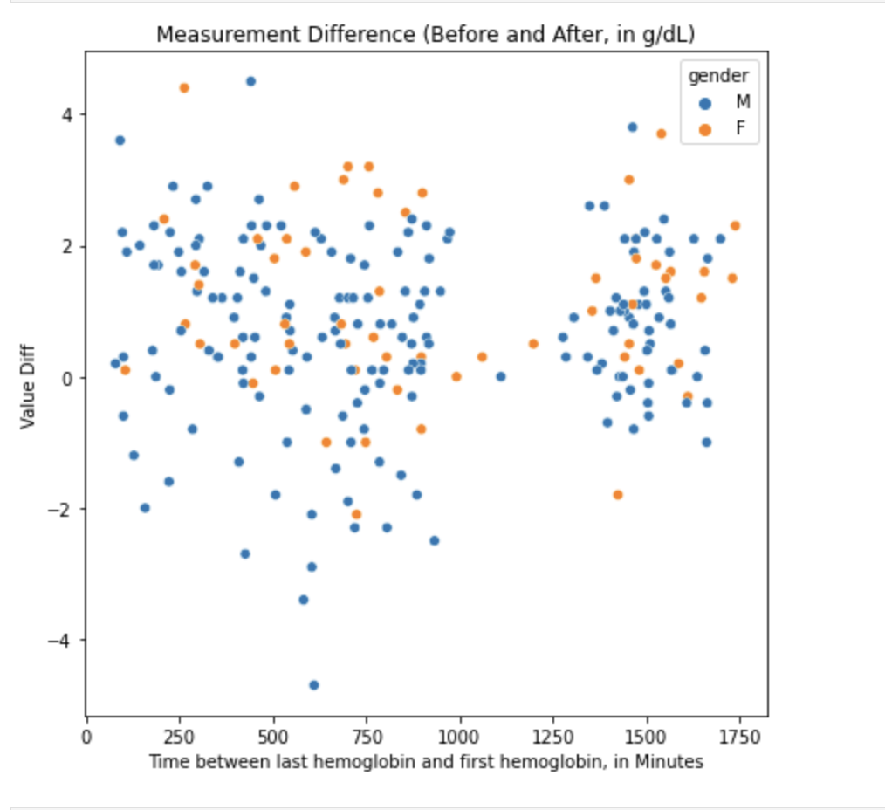
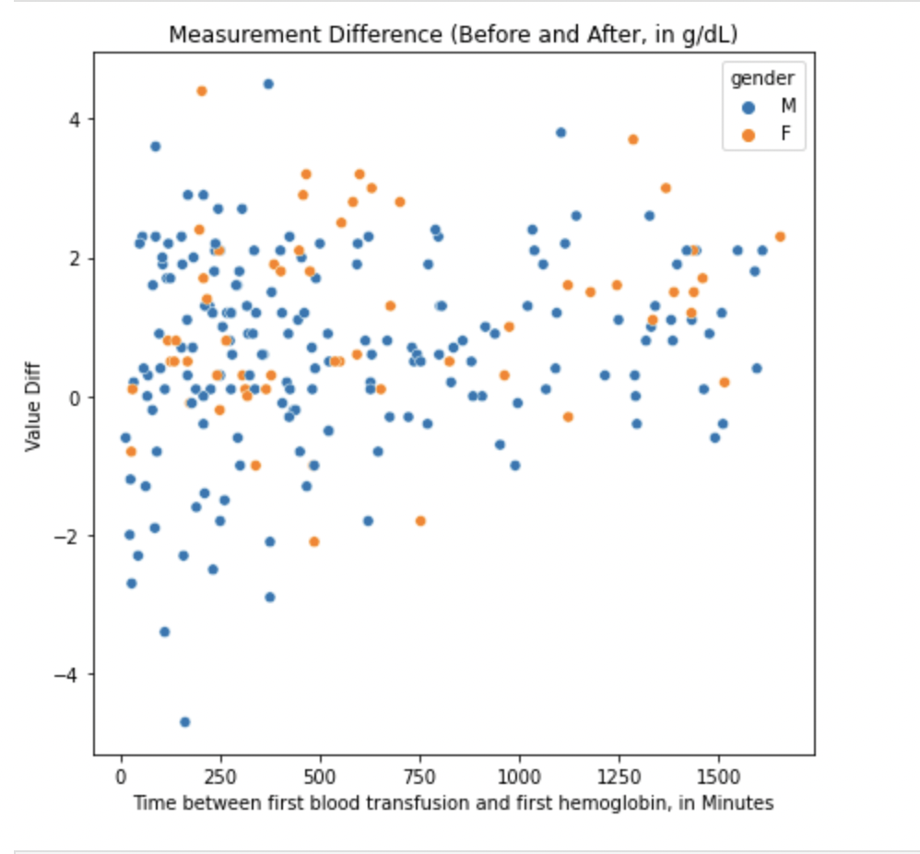
EDA-hemoglobin
Notes:
Left scatter plot is about value diff vs time between last Hb and first HB: latter the time first hemoglobin measured after Transfusion measure value diff is greater which mean there is more increase in hemoglobin value (and we find the for most case the observed value diff is negative which mean the bleed speed is faster than the blood transfusion provide located when time gap between measurement is small)
Left scatter plot is about value diff vs time between first blood transfusion and first HB: latter the time first hemoglobin measured after Transfusion measure, this observation can be more clearly detected
Next I will pass to suyi she will talk about distribution of time for those measurements

Slide 9
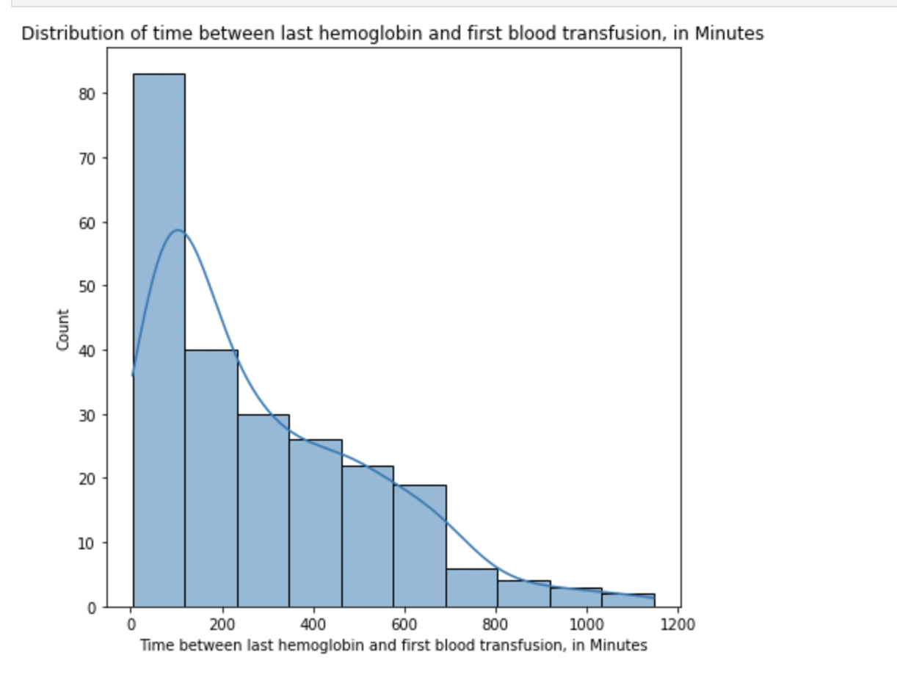
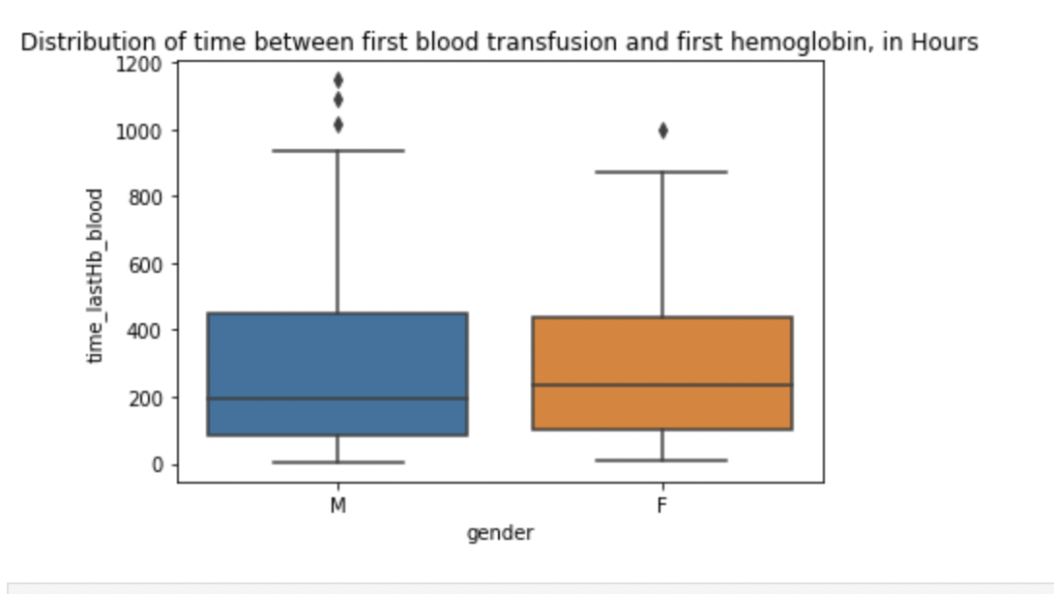
EDA-hemoglobin
Notes:
We can find all the case test last hemoglobin one day before first blood transfusion(0.83 day) 75% of them test within 400 min(around6.7 hours)

Slide 10
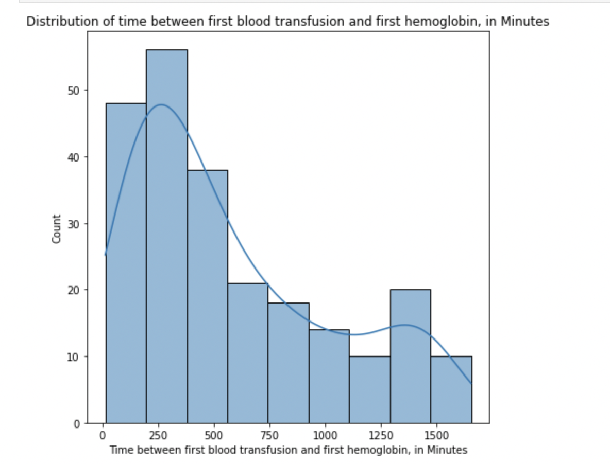
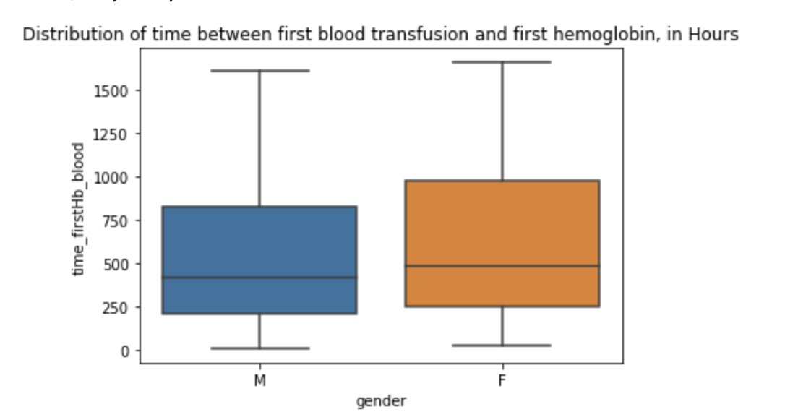
EDA-hemoglobin
Notes:
Compared to the time between last hemoglobin and first blood transfuion shown in last slide; the distribution for the time between first blood transfusion and first hemoglbin is more even. And we can observe there is some cases test first hemoglobin one day after first blood transfusion (greater than 1440min)
Iday = 1440 min

Slide 11
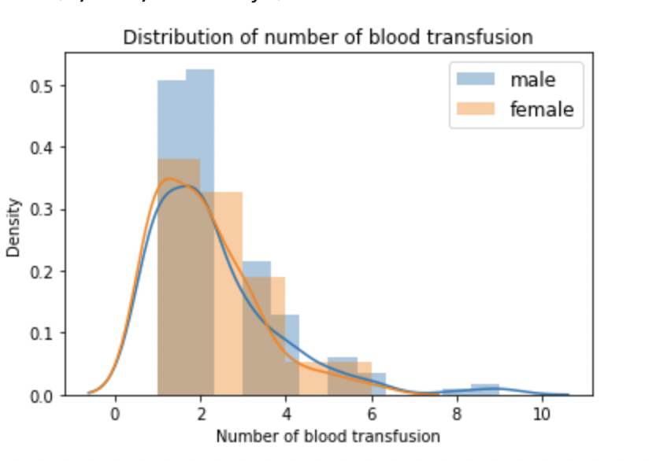
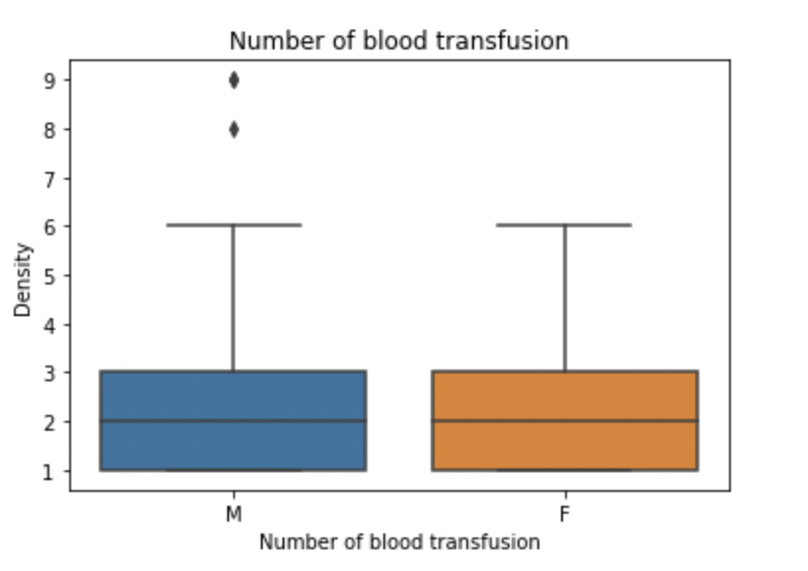
EDA-hemoglobin
Do Men and women receive the same amount of blood transfusion ?
Notes:
Generally there is no much difference in receiving amount of blood transfusion for male and female，but we can detect few male case that receive high amount of blood transfusion 8 times and 9 times

Slide 12
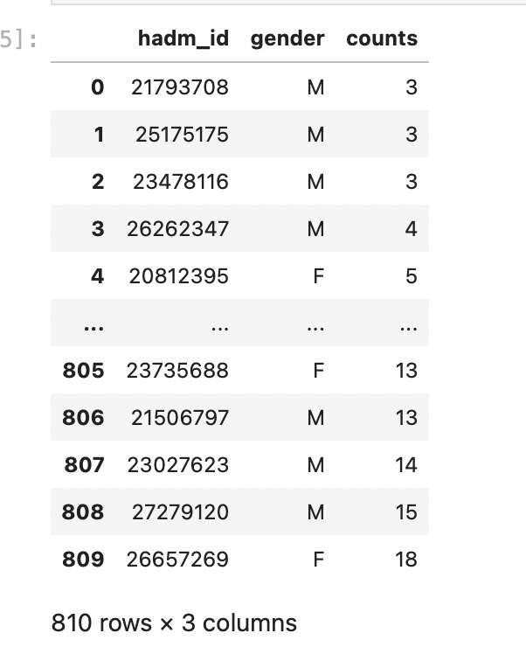
EDA-hemoglobin
How many times the hemoglobin was measured right from the beginning of the surgery to the first 24 hours of the intensive care?
mimic_icu-icustay-inttime
Notes:
892 patient in total 80 donot test Hb in 24h. mean: 6.8->7.5 if remove those 80 patients

Slide 13
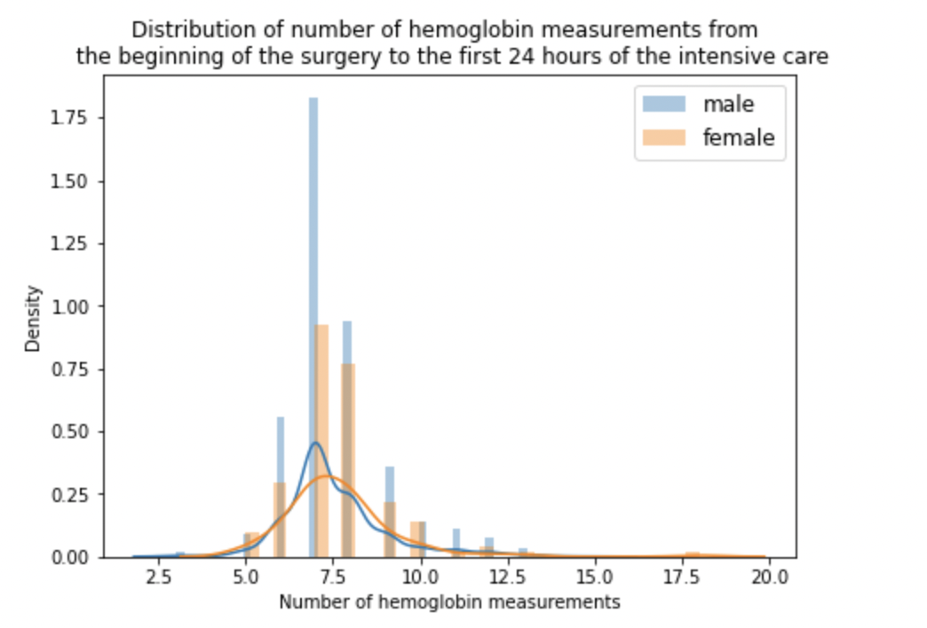
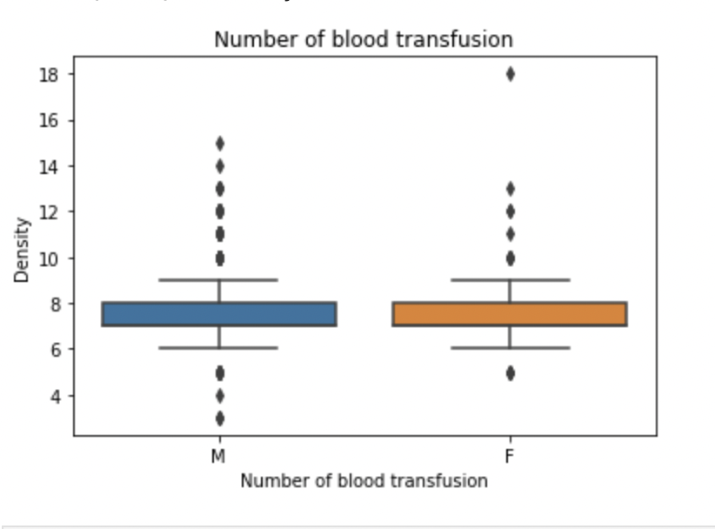
EDA-hemoglobin

Slide 14
EDA-drain
Drain status
mimic-icu output events, labelled as Chest Tube (ml)
Time after last hemoglobin measured and within 1 day before first blood transfusion
Total Drain – sum up Chest Tube value
Drain per minute - Total Drain divided by the time between the earliest time drain status measured and first blood transfusion

Slide 15
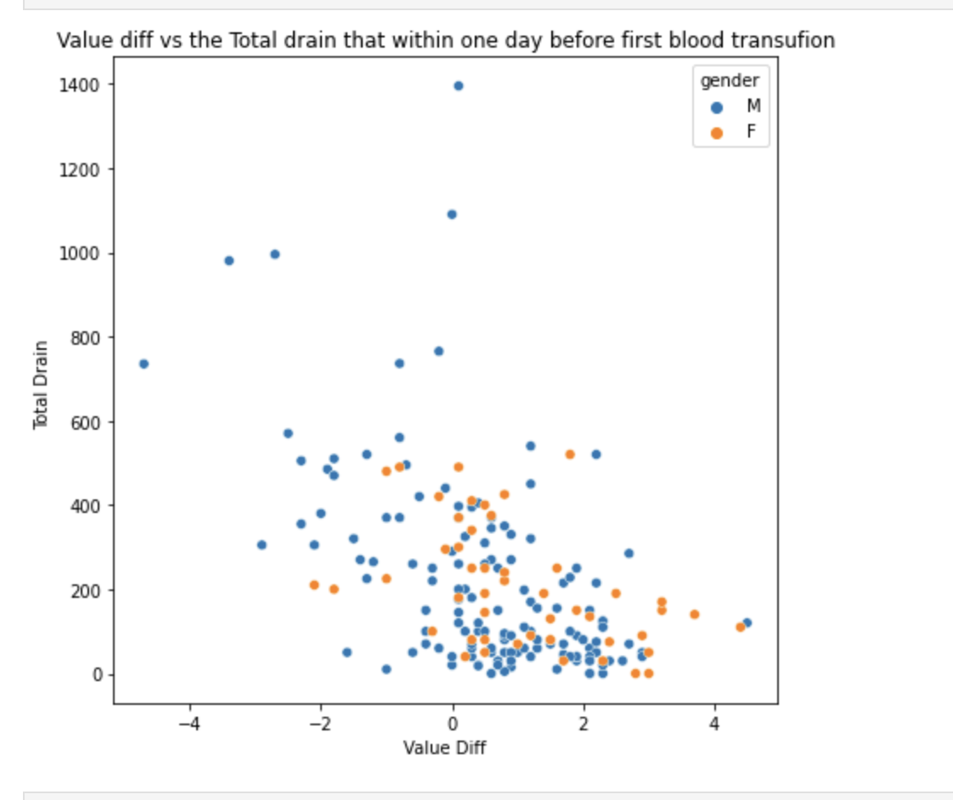
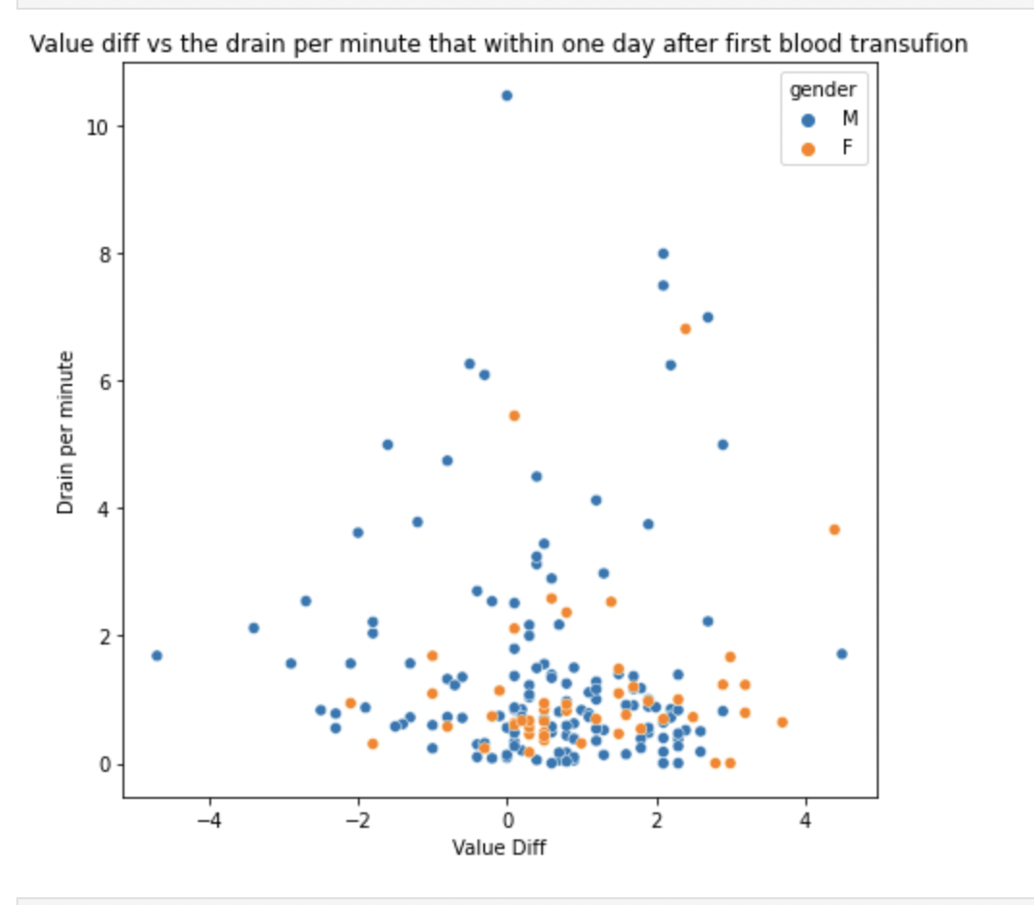
EDA-drain
Notes:
For total drain vs value diff, we can find there is no case that total drain greater than 600 whan value diff is positive, however when we plot the drain per minute rather than total drain, we can nolonger observe this trend.

Slide 16
Thank you!

